Slide 1

Automatic Tear Film Break-Up Analysis
Fundamentals of Image Processing and Analysis (2025/26)
Sebastian Sjøen-Tollaksvik
FEUP — University of Porto

Slide 2

Motivation
• Dry Eye Syndrome affects a large population
• Break-Up Time (BUT) test evaluates tear film stability
• Manual analysis is slow and subjective
• Goal: build a supportive automatic tool

Slide 3
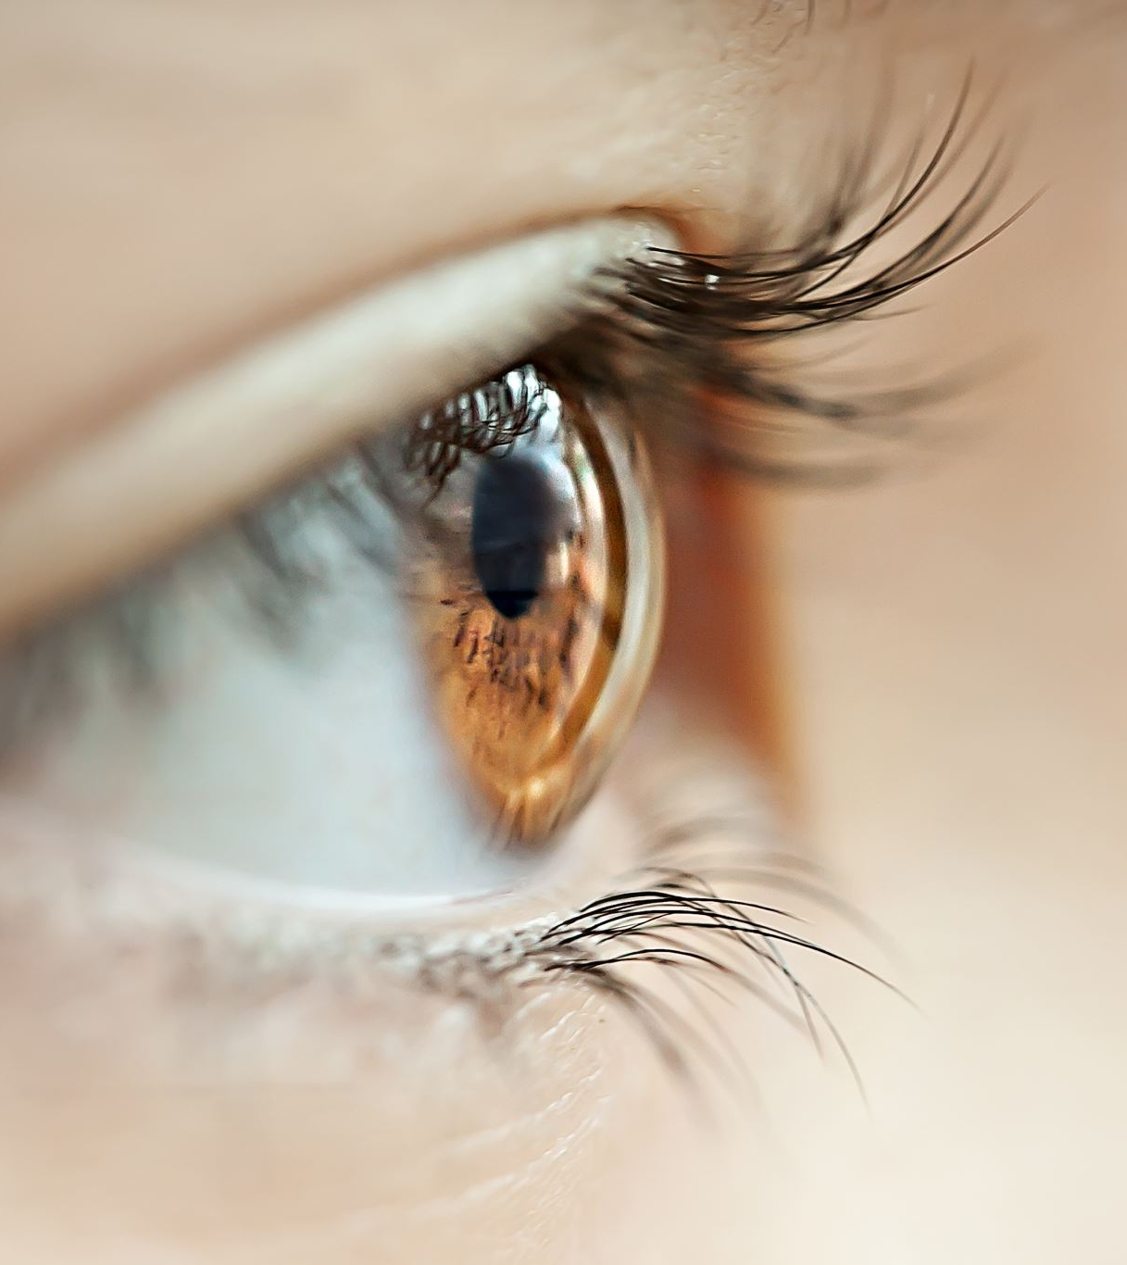
Problem Statement
Input:
• Sequence of eye images from a BUT test
Output:
• Iris region of interest (ROI)
• Tear film break-up detection
Constraint:
• Classical computer vision only (no ML)

Slide 4
Dataset
• 8 BUT test recordings
• Image sequences between blinks
• Ground-truth file: filename ; breakup (0/1)
• Break-up appears as dark regions on the iris

Slide 5
Method Overview
1. Image preprocessing
2. ROI extraction (iris detection)
3. ROI standardization
4. Dark region segmentation
5. Area-based break-up decision

Slide 6
Task 1: ROI Extraction
Goal:
• Isolate the iris
• Remove eyelids, eyelashes, eyebrows
• Align frames within each sequence
Methods:
• Histogram equalization
• Gaussian blur
• Hough Circle Transform

Slide 7
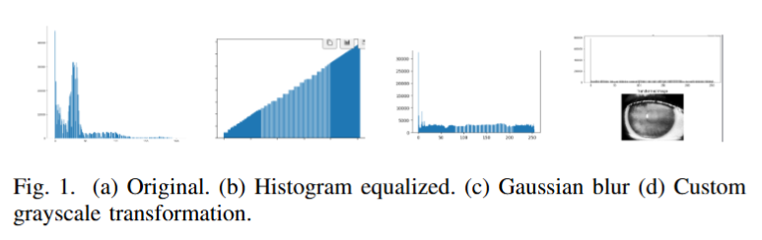
ROI Preprocessing
• Uneven intensity distribution in raw images
• Histogram equalization improves contrast
• Gaussian blur reduces noise
• Lowest 10% intensities set to zero

Slide 8
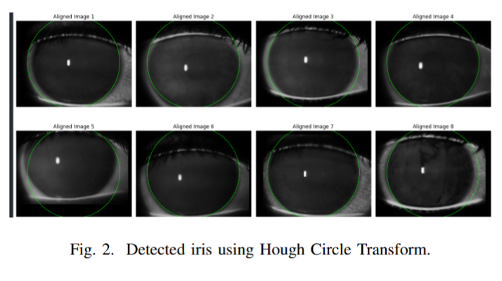

Iris Detection
• Iris modeled as a circle
• Hough Circle Transform detects center and radius
• Radius range constrained to avoid false detections
• One circle detected per frame

Slide 9

ROI Standardization
• Radius reduced (× 0.69) to avoid eyebrow noise
• Mean center and radius computed across frames
• Same ROI applied to all frames
• Improves consistency

Slide 10
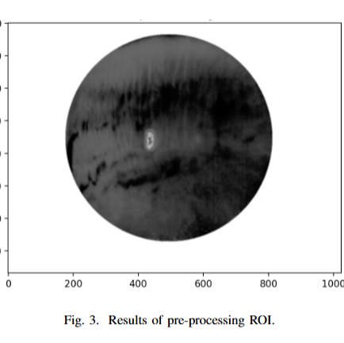
Task 2: Break-Up Analysis
Goal:
• Detect dark regions inside the iris
• Decide break-up based on region size
Challenge:
• Noise and illumination variability

Slide 11
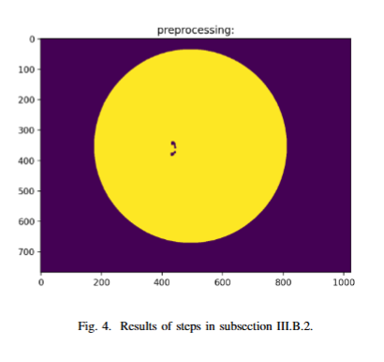
Dark Region Preprocessing
• Extract green channel
• Histogram equalization
• Gaussian blur
• Improves separation of dark and bright regions

Slide 12

Dark Region Segmentation
• Otsu’s thresholding (binary inverse)
• Morphological opening and closing
• Bitwise AND masking
• Canny edge detection

Slide 13
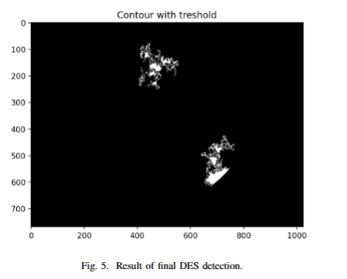
Area Thresholding
• Contour extraction from segmented regions
• Small areas removed as noise
• Large areas removed as artifacts
• Remaining regions marked as tear film break-up

Slide 14
Results
ROI Extraction:
• Consistent iris detection
• Stable alignment across sequences
Break-Up Detection:
• Reliable dark region detection
• Sensitive to parameter tuning

Slide 15
Conclusion
• Fully image-based tear film break-up tool
• Robust ROI extraction using Hough circles
• Effective dark region detection with tuning
• Designed as a support tool, not a classifier

Slide 16
